Slide 1

SbeSCAPE
NOVA SCHOOL OF ECONOMICS AND BUSINESS
Web and Cloud Computing
Professor: João Costa Seco
- Julia Cheng 60490
- Carolina Aparicio 61582
- Ekaterina Gonchar 59573
- Adam Bernard 60865

Slide 2

Travel made easy
SBEscape streamlines your travel by effortlessly finding flights and accomodation, ensuring a seamless journey from start to finish for the NOVA SBE community
Tripadvisor API
https://rapidapi.com/DataCrawler/api/tripadvisor16
S

Slide 3
VIDEO
Recording-20240318_145831.webm

Slide 4
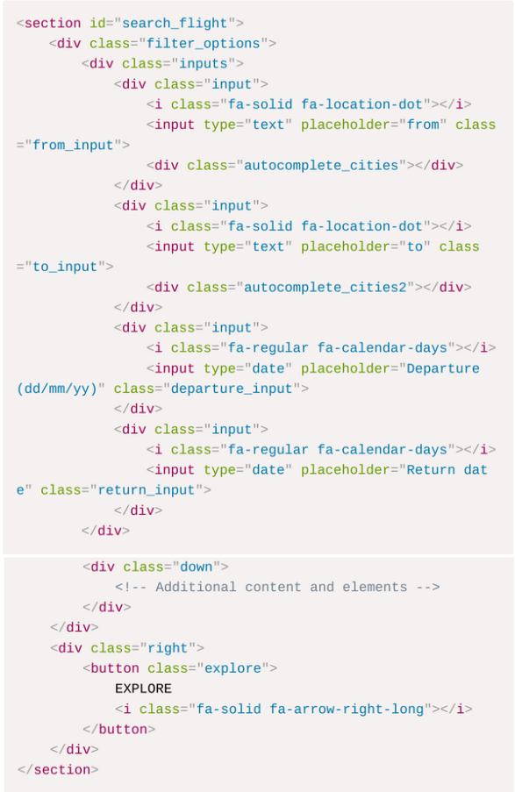
Flight search - html
The website includes a section for users to search for flights, specifiying departure and destination cities, and dates

Slide 5
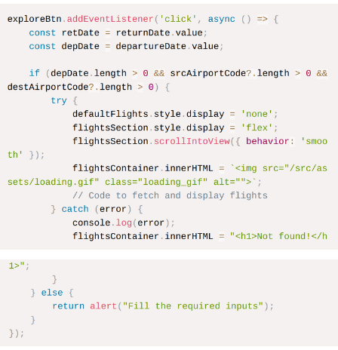
Flight search - js
JavaScript event listeners are attached to the search button, triggering function to collect input values and retrieve flight data

Slide 6
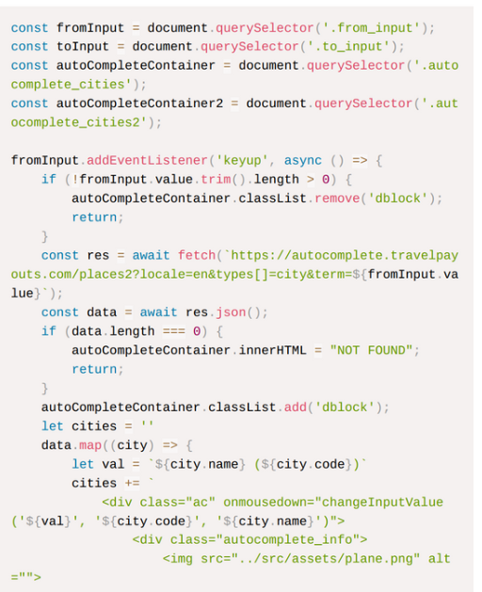
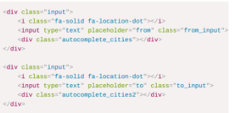
Auto-complete
Two input boxes use auto-complete to suggest city names as the user types, improving user experience and input accuracy

Slide 7
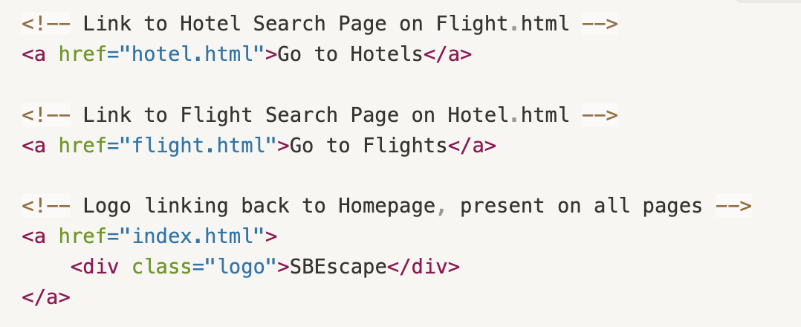
Inter-slide navigation – html
Easy and fast transition between our website’s functionalities
Buttons for navigating from one service to another “Go to Hotels” and “Go to Flights” and logo linking back to the Homepage

Slide 8
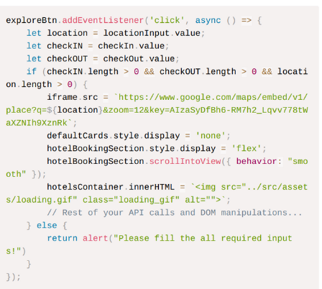
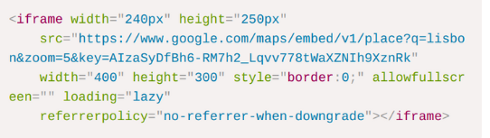
Hotel map
An embedded Google Maps iframe showcases Lisbon, enhacing the user experience with a visual and interactive element

Slide 9
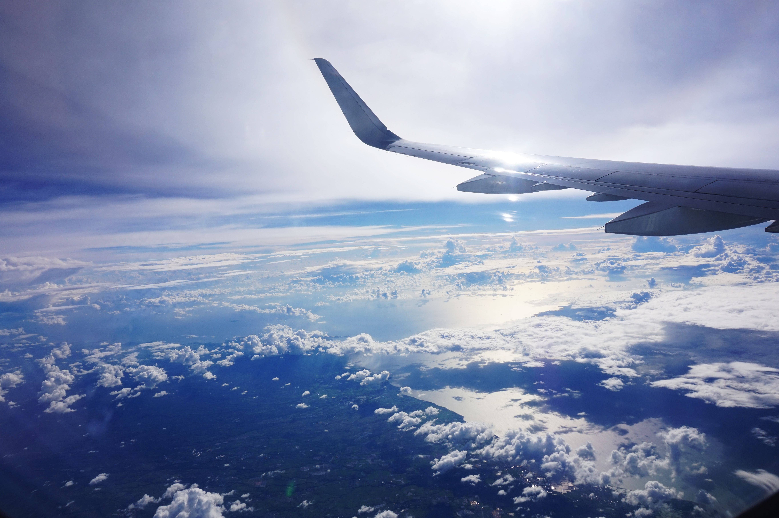
Thank you for your attention !
S

